Slide 1
URBANIC CLONE

Slide 2
TABLE OF CONTENT
INTRODUCTION
EXISTING SYSTEM
OBJECTIVE
SYSTEM REQUIREMENT
TECHNOLOGY
MODULES
SNAPSHOT
FUTURE SCOPE

Slide 3
INTRODUCTION
The Urbanic clone is a web-based e-commerce platform that provides a turnkey solution for businesses and entrepreneurs looking to start their own online store.
This clone replicates the functionality and user experience of the popular Urbanic e-commerce platform, which is known for its user-friendly interface and modern design.

Slide 4
EXISTING SYSTEM
Urbanic e-commerce platform is a popular and powerful tool for businesses looking to create and manage their own online stores, there are several problems with the system that need to be addressed. These problems include:
Cost
Integration
Security

Slide 5
OBJECTIVE
Developing a user-friendly interface that is easy to navigate and use for both businesses and customers.
Providing affordable pricing options for businesses of all sizes, including small startups and entrepreneurs.
Utilizing Integrating with a range of third-party systems and services to streamline business operations and increase efficiency.
Implementing advanced security measures to protect sensitive user and payment information.
Providing comprehensive customer support and technical assistance to ensure that businesses can make the most of the platform's features and capabilities.

Slide 6
TECHNOLOGY
Frontend: HTML,CSS,JAVASCRIPT,BOOTSTRAP
Backend: NODE JS
Database: MONGO DB
Framework: Express JS

Slide 7
MODULES
The modules of the Urbanic clone include:
User Module: The User Module is the primary module of the Urbanic clone and is responsible for managing user accounts, including account creation, login, and account management. This module includes features such as user profiles, account settings, and order history.
Admin module: allows system administrator to set up back-end of the system and perform basic system configuration, mainly definition of predefined drop-down fields, definition of classes time schedule, etc.

Slide 8
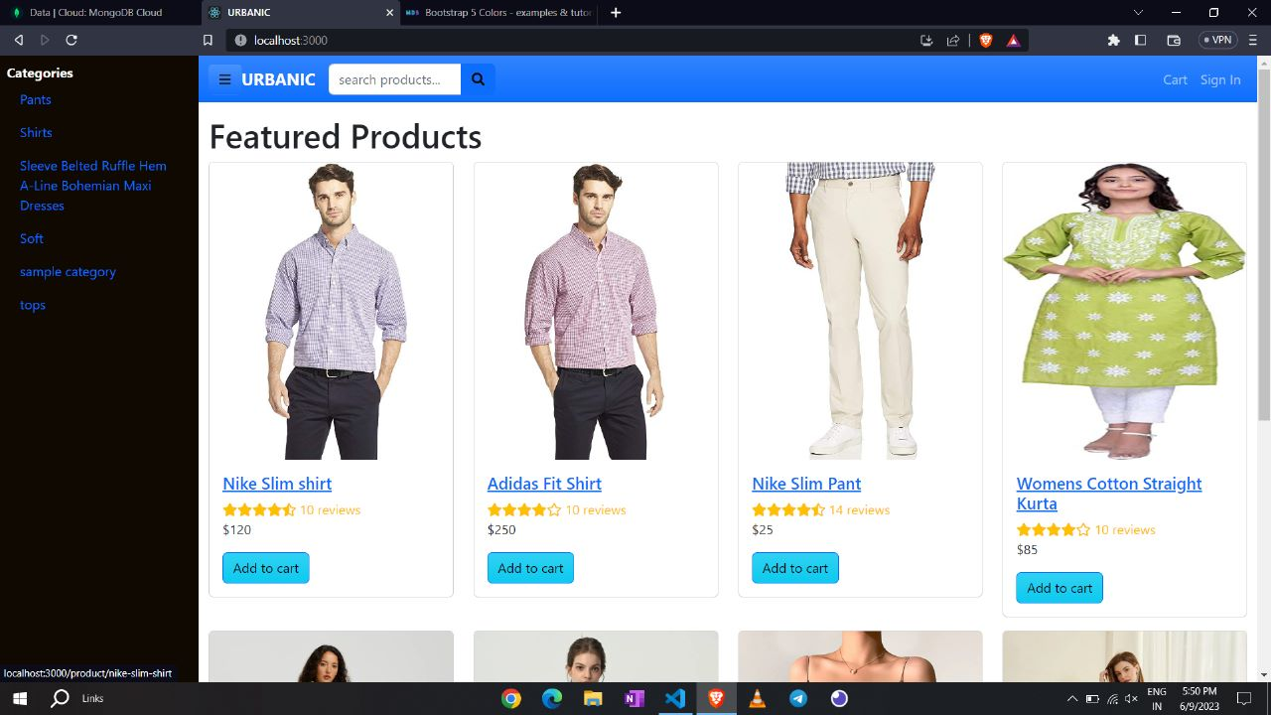
SNAPSHOT

Slide 9
FUTURE SCOPE
As the project gains traction and proves its viability, expanding to new cities and regions can be a significant opportunity.
Urbanic clones can be customized to suit the needs of specific urban areas, offering localized services and solutions.
Future iterations of the Urbanic clone project can integrate emerging technologies such as artificial intelligence, machine learning, Internet of Things (IoT), and blockchain.

Slide 10
THANK YOU

